Slide 1

AInigma presenting you the NAO dance
Saad Salman saad.salman3@studio.unibo.it
Mutahhir Khan hafizmuhammad.khan11@studio.unibo.it

Slide 2

Problems and Constraints
Make NAO perform a choreography using given moves.

Slide 3
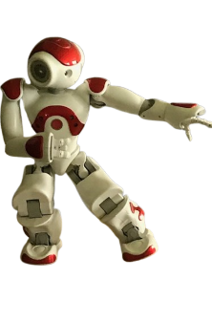
Summary
Constraints (from assignment:)
Must visit mandatory positions P1…P8 in order
(StandInit, Sit, WipeForehead, Hello, SitRelax, Stand, StandZero, Crouch)
Insert intermediate moves between them
Total time ≤ 120 s
Use ≥ 5 intermediate moves overall
Planning must be testable on simulated robot (no real music there)

Slide 4


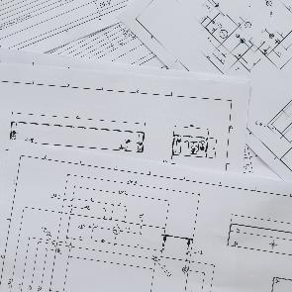

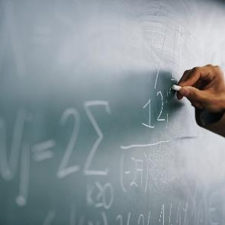

Measuring Move Durations
Why: Algorithm A needs realistic durations for each move.
How we measured:
Created a separate Choregraphe box for each move
Set Motor speed = 100% (Preferences → General)
In each box:
start = time.time() before motion
end = time.time() after motion
self.logger.info("Move X: %.2f s" % (end - start))
Ran moves many times (Sit, SitRelax, Stand, etc.) and took stable values
Result:
Built a Python dictionary DUR = { "P1": 4.04, "Sit": 31.36, ..., "rotation_handgun": 11.87, ... }
1
2
3
4
5
6

Slide 5
Algorithm A (Greedy Planner)
Input:
Mandatory sequence: P1…P8
Intermediate moves (e.g. rotation_handgun, union_arms, move_forward, …)
Durations in DUR
Idea:
For each pair Pi → P(i+1) → choose exactly one intermediate in between: Pi → [Intermediate] → P(i+1)
Greedy choice criteria:
Required moves first (we want some specific moves to appear at least once, e.g. rotation_handgun, move_forward, union_arms, workout, guitar…)
Prefer moves with lower usage so far → avoids always picking the same one
Among those, choose the shortest duration → keeps total time small

Slide 6
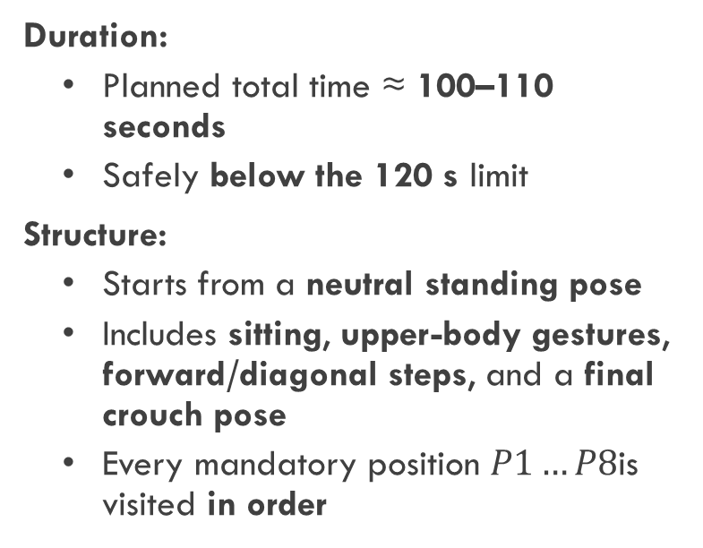
Results of Algorithm A
Choreography properties:
Use of intermediate moves:
At least 7 intermediate moves inserted
No single move is over-used → choreography looks varied, not repetitive
Specific “highlight” moves are forced to appear at least once (e.g. a rotation, a forward step, and a couple of expressive arm gestures)
Automatic validation (printed by main.py):
Time <= 120 s ? OK
#Intermediates >= 5 ? OK
Summary of how many times each move was selected
Duration:
Planned total time ≈ 100–110 seconds
Safely below the 120 s limit
Structure:
Starts from a neutral standing pose
Includes sitting, upper-body gestures, forward/diagonal steps, and a final crouch pose
Every mandatory position $P1…P8$is visited in order

Slide 7
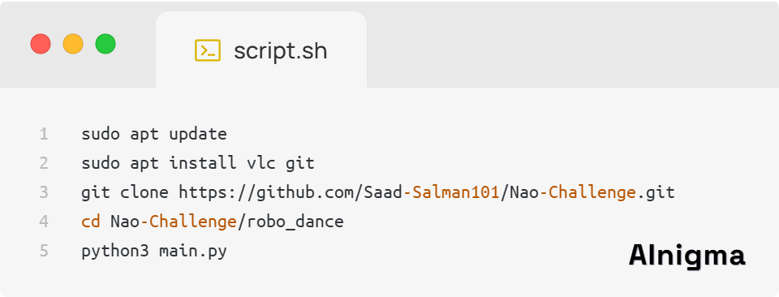
Implementation & How to Run
Environment:
NAOUbuntu VM (provided by course)
Choregraphe with Virtual Robot NAO H25 (V50)
Python 3 for planning (no external libraries needed)
Repository:
GitHub: https://github.com/Saad-Salman101/Nao-Challenge.git

Slide 8
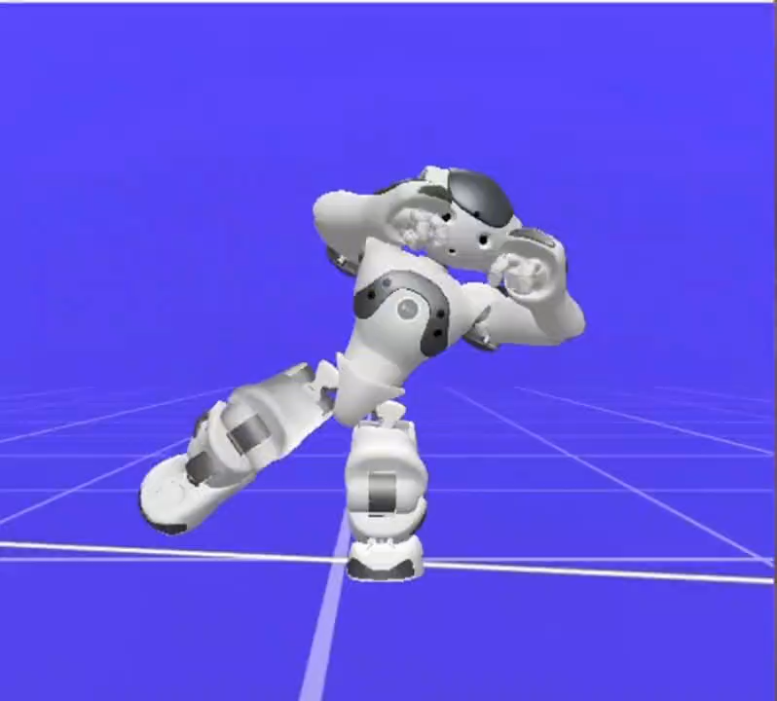
Video slide

Slide 9

Thank You NAO Love you All
This was AInigma for you

